Slide 1

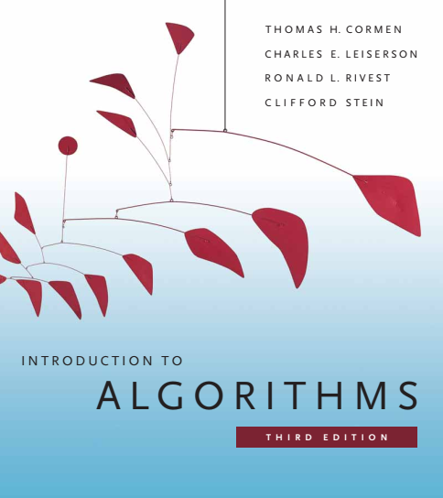
Design and Analysis of Algorithms
Dr. Sajid Iqbal
sajidiqbal.pk@gmail.com
Reference Book
Introduction to Algorithms 3rd Edition By Thomas H. Cormen et. al.
https://mitpress.mit.edu/books/introduction-algorithms-third-edition
COMEDXD

Slide 2
The recursion Method
Binary Search

Slide 3
Background
Break the problem into a number of subproblems that are smaller instances of the same problem
Conquer
Solve the sub-problems recursively. Solve the smallest problems directly
Combine
Combine the solutions to the subproblems into the solution for the original problem
Divide
Divide-n-Conquer consists of three phases
A recurrence is an equation or inequality that describes a function in terms of its value on smaller inputs.

Slide 4
Binary Search
Simple algorithm that uses recursion
Algorithm: A sorted array of numbers (keys)
It Searches a sorted array by dividing the search interval into two half intervals
Middle element is tested to be the search key
If yes, indicate the search is successful
else
Based on specified criteria, one of the search interval is chosen
Search process repeats from step-1

Slide 5
Binary Search Algorithm
Binary Search
6
def BSearch (A, s, e, x):
if e >= s:
mid = s + (e - l) / 2
if A[mid] == x:
return mid
elif A[mid] > x:
return BSearch(A, s, mid-1, x)
else:
return BSearch(A, mid + 1, e, x)
else:
return -1
1 | 5 | 6 | 8 | 9 | 10 | 24 | 30
s
m
e
1 | 5 | 6 | 8 | 9 | 10 | 24 | 30
s
m
e
1 | 5 | 6 | 8 | 9 | 10 | 24 | 30
s
m
e

Slide 6
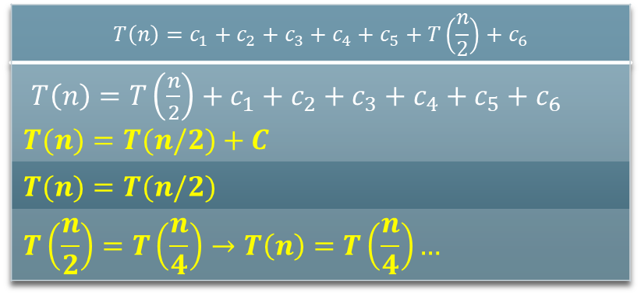
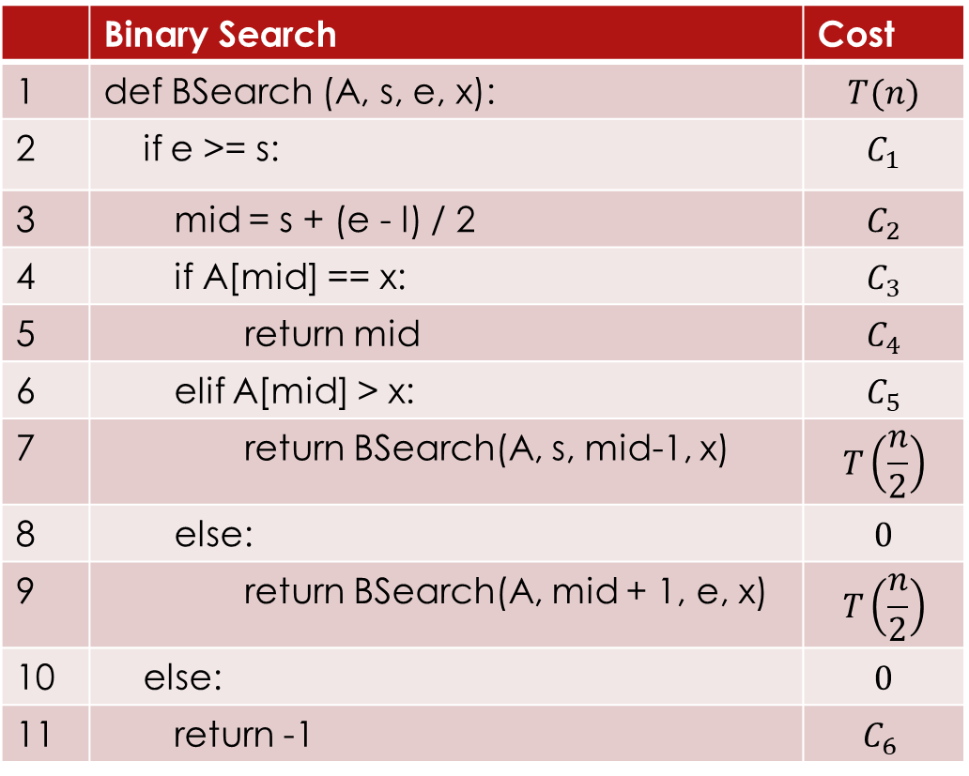
Analysis of Binary Search Algorithm
Let the size of input array is n and suppose that running time of algorithm is T(n)
 | Binary Search | Cost
1 | def BSearch (A, s, e, x): | $$T(n)$$
2 | if e >= s: | $$C_{1}$$
3 | mid = s + (e - l) / 2 | $$C_{2}$$
4 | if A[mid] == x: | $$C_{3}$$
5 | return mid | $$C_{4}$$
6 | elif A[mid] > x: | $$C_{5}$$
7 | return BSearch(A, s, mid-1, x) | $$T\left(\frac{n}{2}\right)$$
8 | else: | $$0$$
9 | return BSearch(A, mid + 1, e, x) | $$T\left(\frac{n}{2}\right)$$
10 | else: | $$0$$
11 | return -1 | $$C_{6}$$
$$T\left(n\right)=c_{1}+c_{2}+c_{3}+c_{4}+c_{5}+T\left(\frac{n}{2}\right)+c_{6}$$
$T\left(n\right)={T\left(\frac{n}{2}\right)+c}_{1}+c_{2}+c_{3}+c_{4}+c_{5}+c_{6}$ $$T(n)=T(n/2)+C$$
$$T(n)=T(n/2)$$
$$T\left(\frac{n}{2}\right)=T\left(\frac{n}{4}\right)→T\left(n\right)=T\left(\frac{n}{4}\right)…$$

Slide 7
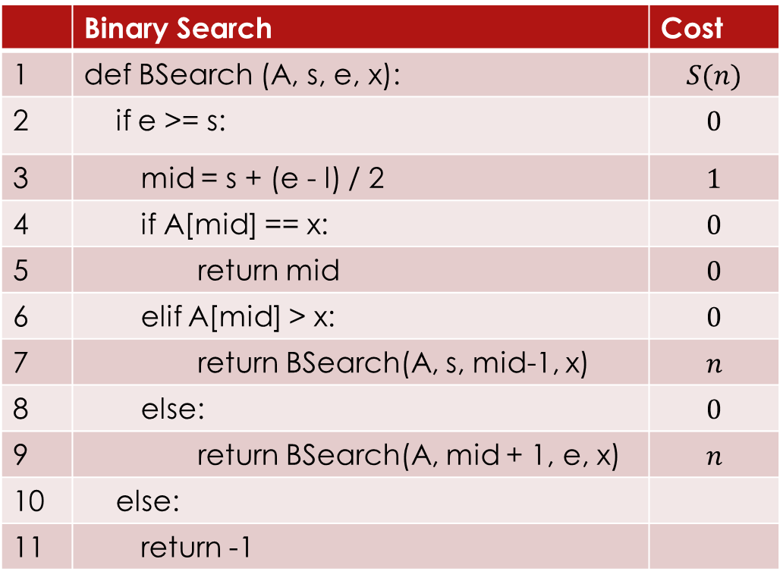
Space Complexity
S(n)=n+1
For each recursive call same array is passed, only values of pointers are changed.
No extra space is required
 | Binary Search | Cost
1 | def BSearch (A, s, e, x): | $$S(n)$$
2 | if e >= s: | $$0$$
3 | mid = s + (e - l) / 2 | $$1$$
4 | if A[mid] == x: | $$0$$
5 | return mid | $$0$$
6 | elif A[mid] > x: | $$0$$
7 | return BSearch(A, s, mid-1, x) | $$n$$
8 | else: | $$0$$
9 | return BSearch(A, mid + 1, e, x) | $$n$$
10 | else:
11 | return -1

Slide 8
Thanks for watching
Dr. Sajid Iqbal
Assistant Professor
Department of Computer Science
Bahauddin Zakariya University, Multan
Allah Hafiz

